Slide 1
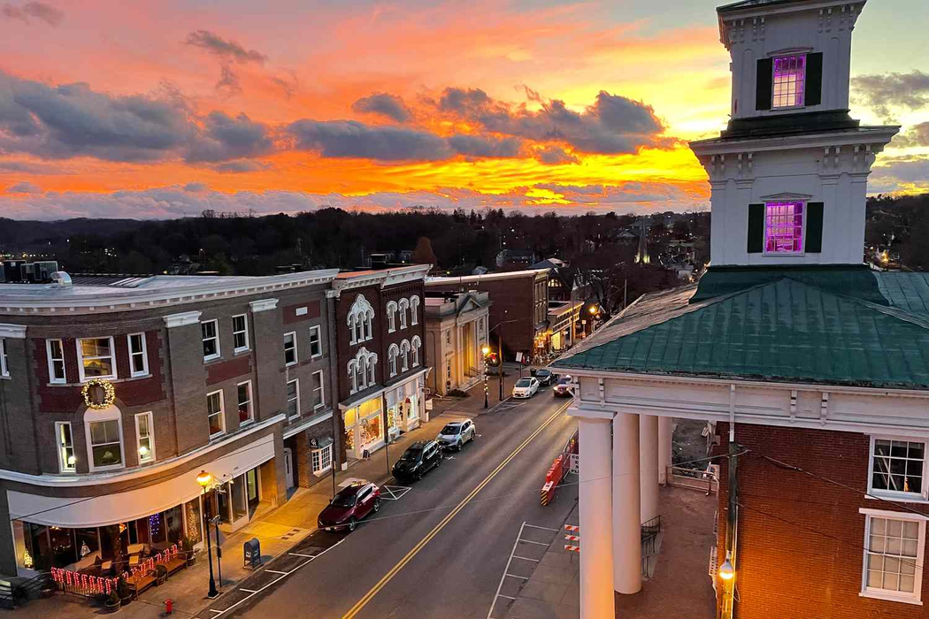

Values-Based Leadership
Is Transformational Leadership
Presented by Michael Gallagher
MK Leadership
Small Towns Conference - 2024 - Abingdon, VA

Slide 2

I am a person of value
who values people
and adds value to them.

Slide 3
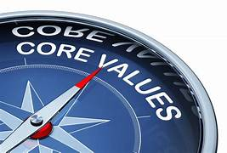
I am a person of value.
Why are core values important?
•They communicate what is important to you.
•They influence your behaviors.
•They inspire you.
•They help you make decisions.

Slide 4
I am a person of value.
Step 1: Choose your top 15 values
Step 2: Reduce to top 8 values
Step 3: Now pick your top 5 values

Slide 5
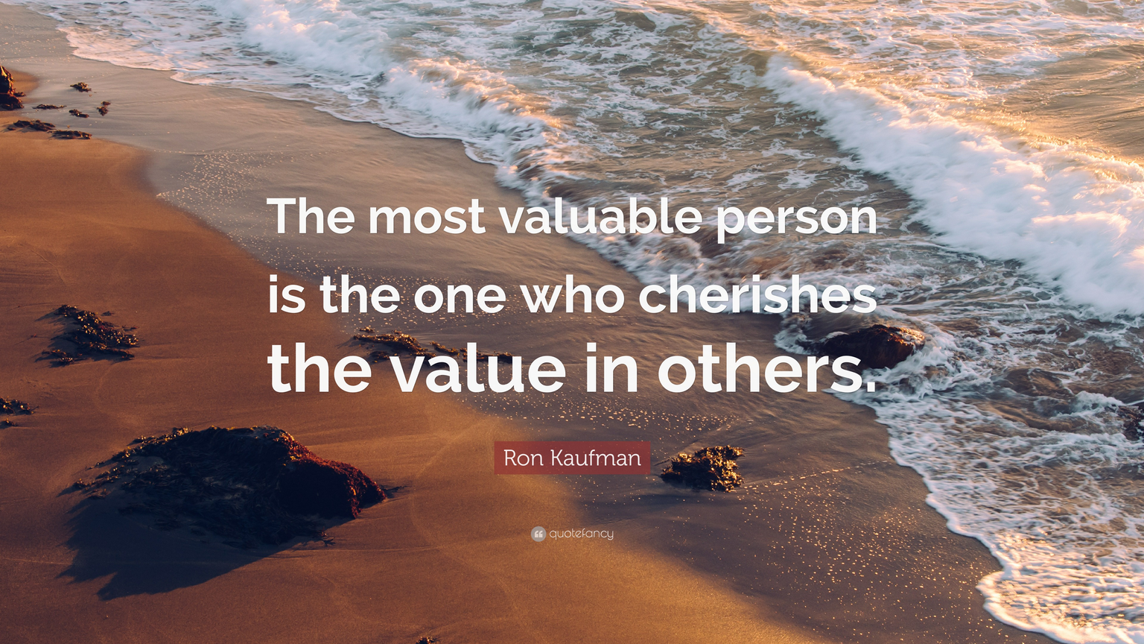
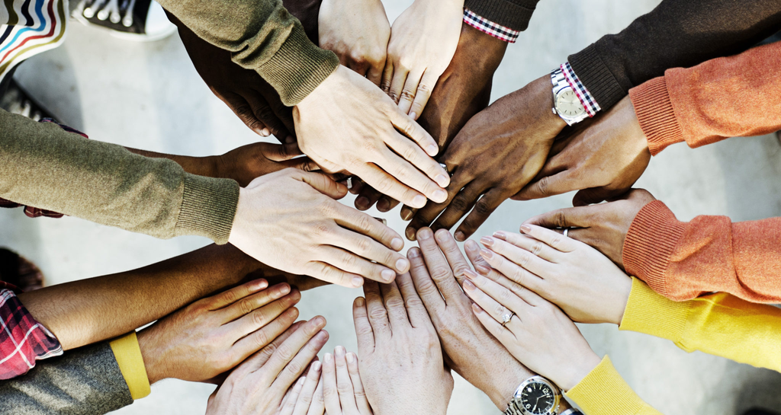
I am a person who values others.
And when I do, I will...
•Build Trust.
•Create a Positive Environment.
•Promote Diversity and Inclusion.

Slide 6

3 ways to Value Others
Active Listening
Honesy & Integrity

Slide 7

3 ways to Value Others
Active Listening
Express Gratitude
Honesy & Integrity

Slide 8
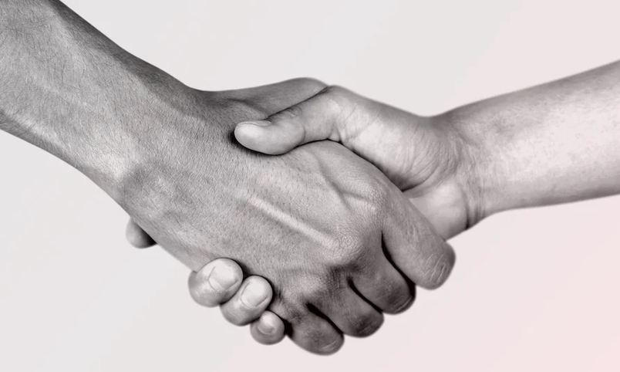
3 ways to Value Others
Active Listening
Express Gratitude
Honesty & Integrity

Slide 9


Seven Words I Will Never Forget...
You -
...and you

Slide 10
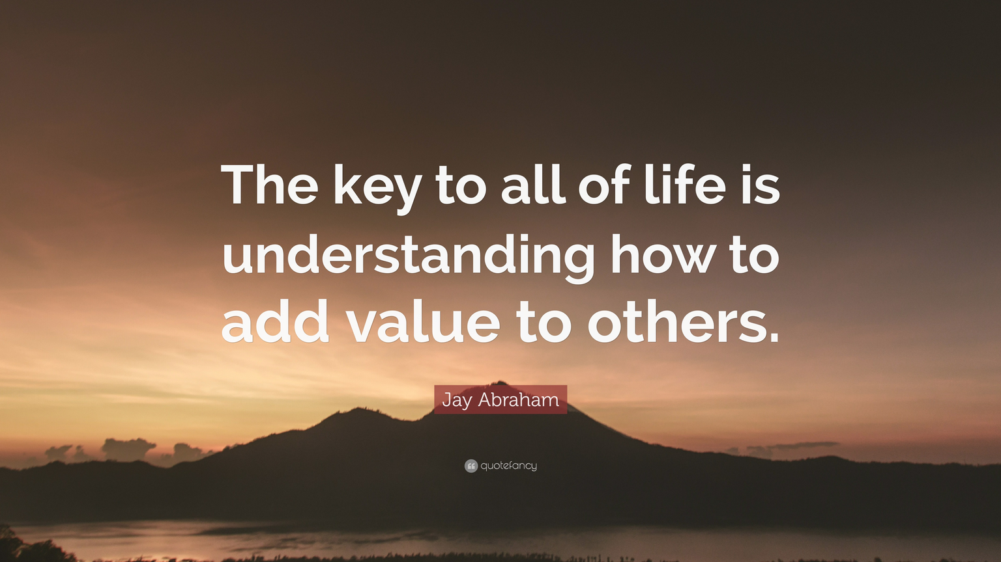

I am a person who adds value to others.
It is essential for:
•Fostering a Positive Environment.
•Encouraging Growth.
•Boosting Overall Team Performance.

Slide 11
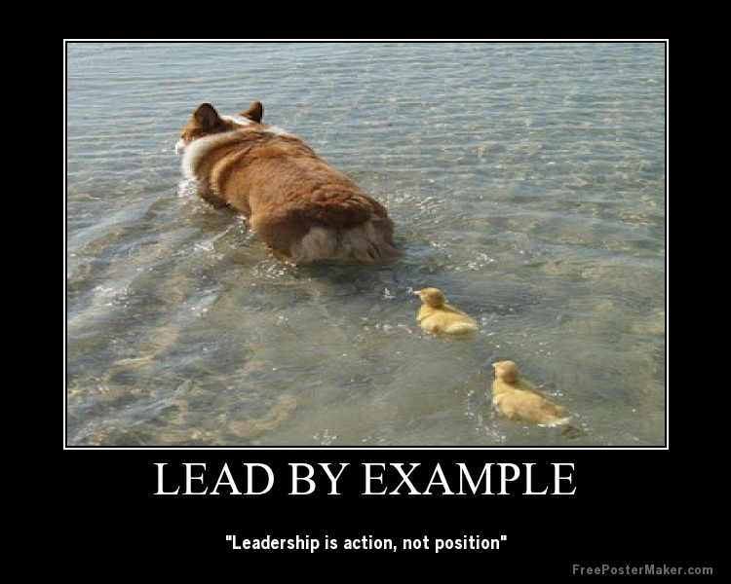
3 ways to Add Value to Others
Lead by Example
Honesy & Integrity

Slide 12

3 ways to Add Value to Others
Lead by Example
Encourage Autonomy
Honesy & Integrity

Slide 13
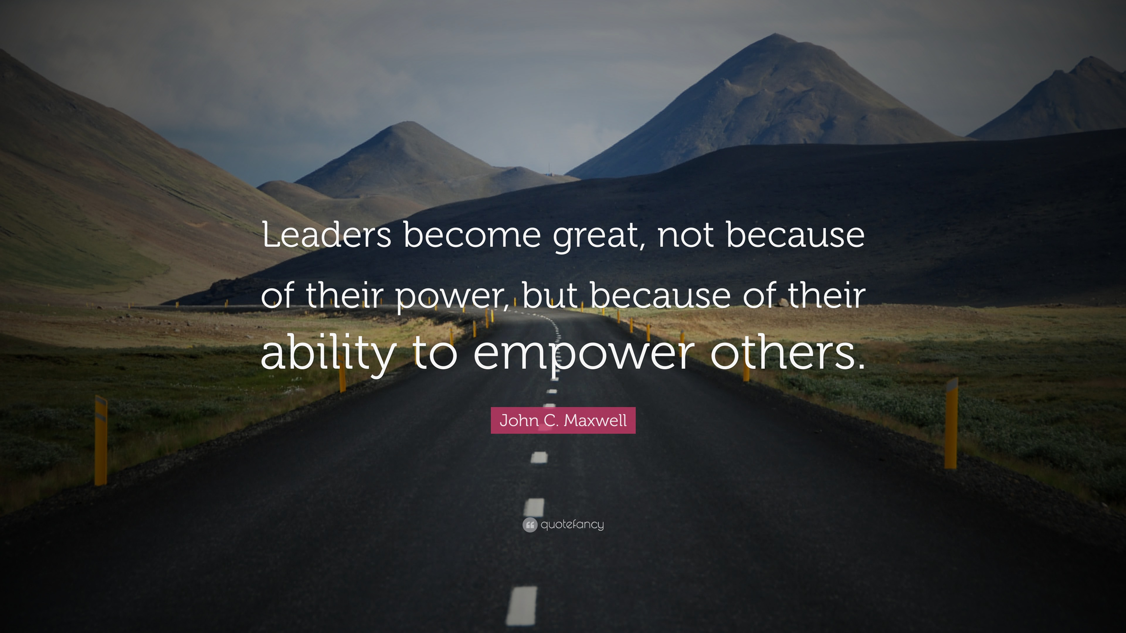

Slide 14

3 ways to Add Value to Others
Lead by Example
Encourage Autonomy
Provide Growth Opportunities

Slide 15

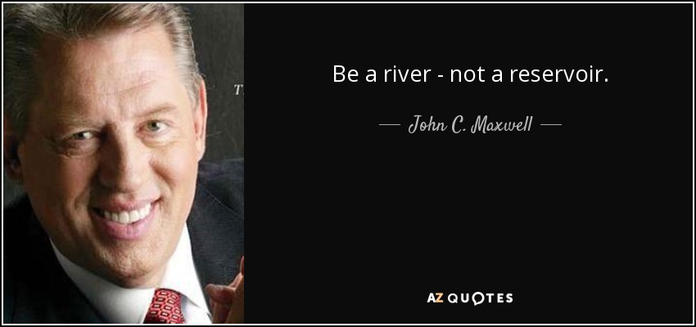

Slide 16
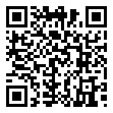
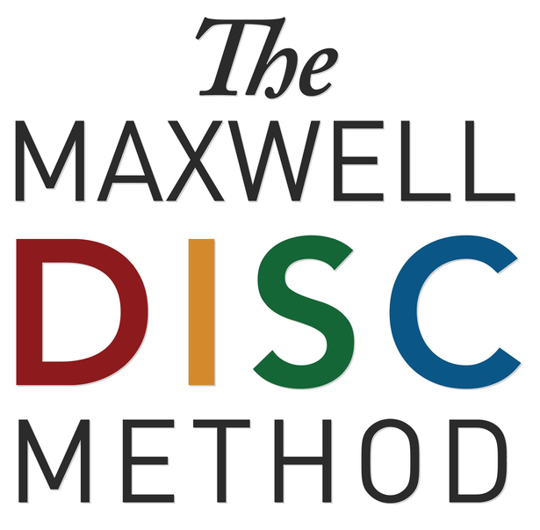

MK LEADERSHIP
MICHAEL GALLAGHER
Maxwell Leadership Certified Team
Coach, Trainer & Speaker
CONTACT ME:
703-965-0481
Michael@mkleadership.net
or scan the code:
Certified Facilitator for:
DISC &
Working Genius
Assessments

